Slide 1
Lab meeting Pilar Corredor-Moreno 27th October 2015
A Genome-Wide Association Study of Resistance to Stripe Rust (Puccinia striiformis f. sp. tritici) in a Worldwide Collection of Hexaploid Spring Wheat (Triticum aestivum L.)
Notes:
So today I’m going to talk about this publication from March in which they

Slide 2
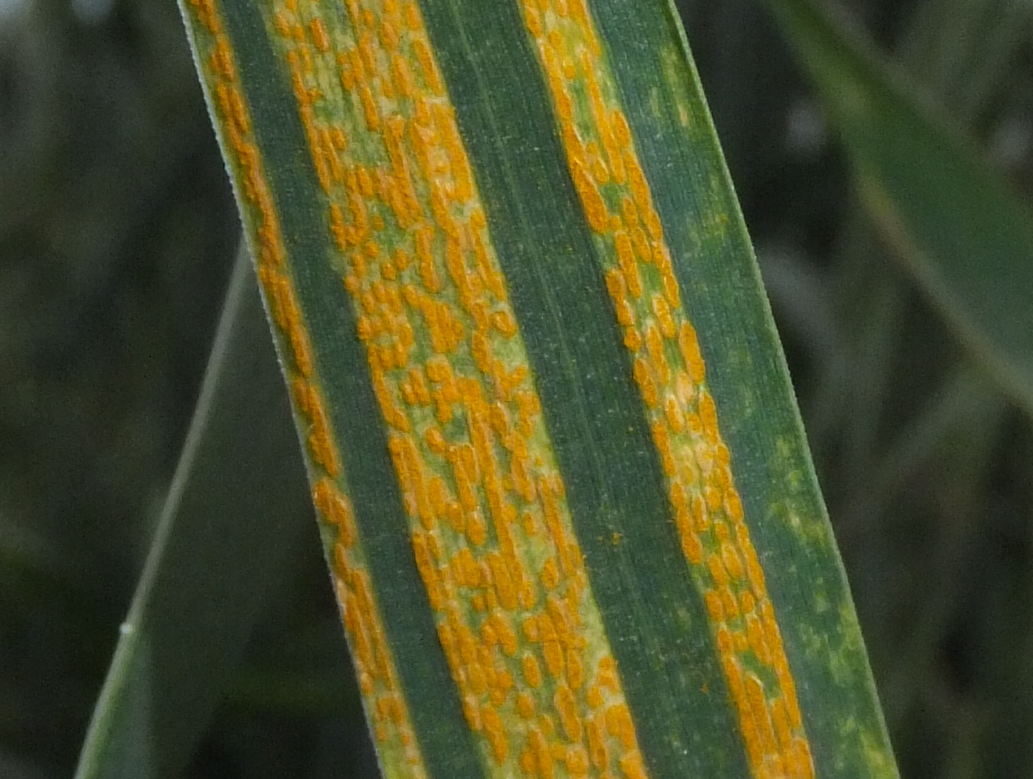
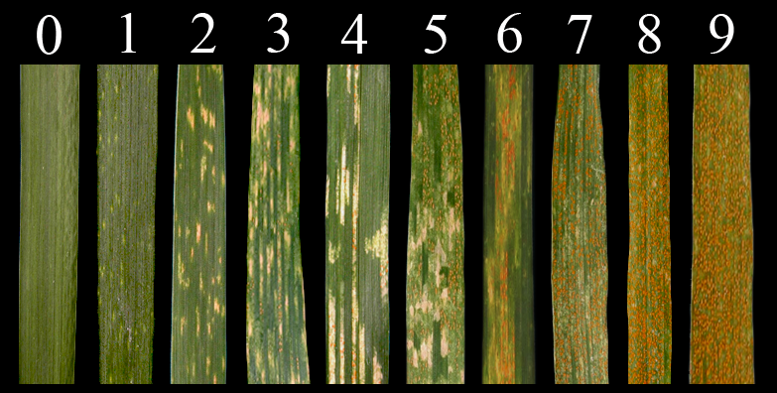
Chen, X. M. et al, 2005
Pst resistance genes
Race-specific
Race nonspecific
Qualitative or Partial resistance
Strong hypersensitive response
Notes:
Stripe rust disease of wheat, caused by the fungus Puccinia striiformis Westend. f. sp. tritici Erikss. (henceforth Pst), poses a major threat to global wheat production and negatively affects grain quality. Although multiple fungicide applications can control this pathogen, developing resistant varieties is the most efficient and environmentally sustainable means for reducing losses due to this disease. New races of Puccinia striiformis f. sp. tritici (Pst), the causal pathogen of wheat stripe rust, show high virulence to previously deployed resistance genes and are responsible for large yield losses worldwide.
Pst accessions classified based on their virulence profile on a set of wheat lines
Pst resistance genes are classified as either race-specific or race nonspecific based on their effectiveness against different Pst races. Race-specific resistance genes, which are effective only against a subset of races, usually are expressed from the seedling to the adult plant stages and generally result in a strong hypersensitive response associated with high levels of resistance. Race nonspecific resistance genes are effective against all Pst races, generally are expressed at adult plant stages, and are characterized by various degrees of resistance (quantitative or partial re- sistance). Many of these partial resistance genes exhibit enhanced resistance at high temperatures and are designated as high-tempera- ture adult plant resistance genes (Chen 2013). Pyramiding multiple partial resistance genes is required to confer adequate levels of re- sistance (Singh et al. 2000; Singh et al. 2005). Both race-specific and race nonspecific resistance or partial resistance genes have been used in breeding for rust resistance (Chen 2005; Lowe et al. 2011a). How- ever, high genetic variation in the pathogen population and the rapid rate of selection for new virulent races have forced wheat breeders to focus on pyramiding strategies that combine multiple race-specific and/or race nonspecific resistance genes to increase the durability of the deployed resistance.

Slide 3
Breeding for rust resistance
Yr genes identified
We need more!
New races of Pst show high virulence to previously defined resistance genes (Yr genes)
Race-specific
Pyramiding strategies
Race nonspecific
Notes:
However, high genetic variation in the pathogen population and the rapid rate of selection for new virulent races have forced wheat breeders to focus on pyramiding strategies that combine multiple race-specific and/or race nonspecific resistance genes to increase the durability of the deployed resistance.

Slide 4
GWAS
1000 accessions from the spring wheat core collection from 89 countries
SNP genotyping
Stripe rust response evaluation
Field trial for adult plants
Seedling test
Infinum wheat SNP 9k iSelect assay developed by the IWSC
Infection Type (IT)
0-9
Severity (SEV)
% infected leaf area
Notes:
is an examination of many common genetic variants in different individuals to see if any variant is associated with a trait.
One thousand accessions were selected randomly from the 2235 Tri- ticum aestivum ssp. aestivum accessions available in the spring wheat core collection assembled by the USDA-ARS Small Grains and Potato Germplasm Research Unit.
Accessions from 89 countries were represented in this study, including accessions from South America (20.9%), Africa (20.6%), Europe (19.6%), Asia (29.1%), North America (7.0%), and Australia (2.8%).
The infection type (IT) was scored using a 0-9 scale described previously (Line and Qayoum 1992). Disease severity (SEV) was scored as per- centage of infected leaf area. Additionally, days to heading and plant height were evaluated to test their correlation with Pst resistance. Other morphophysiological traits such as occurrence of pseudo-black chaff, awns, wax, and glume hairiness were recorded as controls for line identification.
Infinium wheat SNP 9K iSelect assay from the Illumina platform (Illumina Inc., San Diego, CA) developed by the International Wheat SNP Consortium (Cavanagh et al. 2013). The raw Illumina SNP data were processed with the GenomeStudio v2011.1 software (Illumina). The array yielded 5234 scorable SNP markers. The polymorphic SNPs were ordered according to the scaled map positions of the hexaploid wheat 9K SNP consensus map (

Slide 5
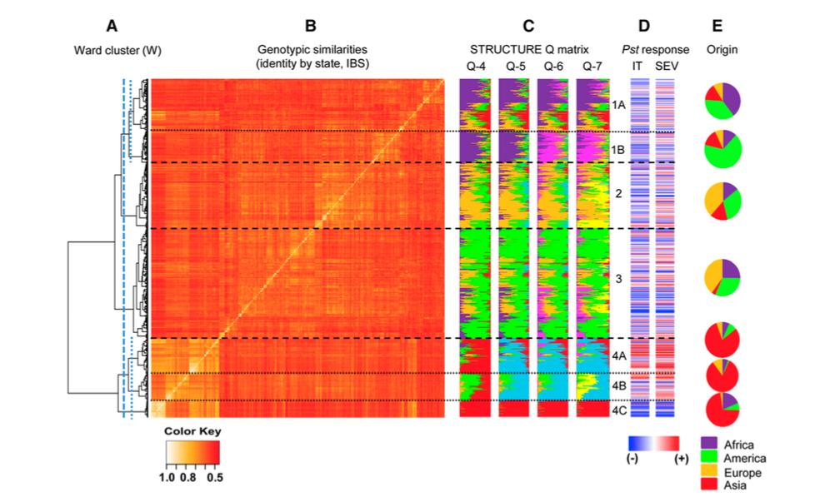
Spring wheat population structure
Notes:
They cluster the accesions looking at the genotypic similarities and the type of response (infection type and severity) to PST. revealed a major division between the subpopulations enriched in accessions from Asia (4A, 4B, and 4C, henceforth “Asian” subpopulations) and subpopulations that include a large proportion of accessions from other parts of the world (1A, 1B, 2, and 3, henceforth “Western” subpopulations).

Slide 6
Spring wheat population structure
Western
2
3
4B
Asian
1A
4A
4C
1B
Notes:
High degree of admixture (the result of interbreeding between two or more previously isolated populations within a species, particularly among cultivars and modern breeding materials. This is a result of the germplasm exchange that characterizes modern wheat breeding worldwide.
The “Western” subpopulations include a large proportion of materials released after 1960 (55%), which were likely influenced by the Green Revolution. CIMMYT (Centro Internacional de Mejoramiento de Maíz y Trigo) played a central role in the development and distri- bution of these Green Revolution varieties, and accounts for 90% of the accessions from Mexico presented in Figure 1. CIMMYT lines in this collection belong mainly to the four “Western” subpopulations, which may explain the abundance of these subpopulations in regions that frequently receive or exchange germplasm with CIMMYT

Slide 7
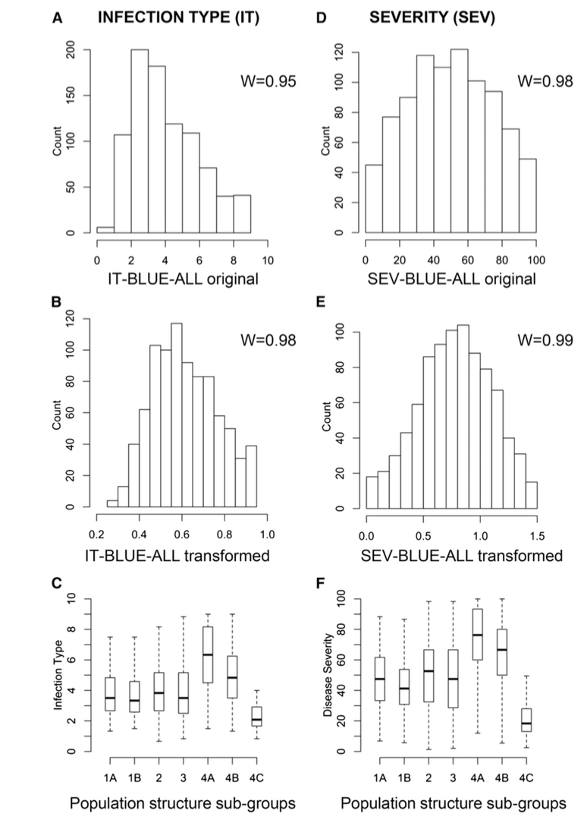
Response to PST
13% of accessions with IT 0-2 (highly resistant)
17% of accessions with IT 7-9 (highly susceptible)
Susceptibility
Chen, X. M. et al, 2005
Susceptible accessions
Resistant accessions
Notes:
Phenotypic variation was observed in all environments, with infection types ranging from highly resistant (13% of accessions with IT 0-2) to highly susceptible (17% of acces- sions with IT 7-9). The frequency distributions of BLUE-all values for IT and SEV were approximately normal, with a slight shift in the IT response toward resistance.
In general, we don’t see a high effect of genetic variation on IT or SEV. The high IT and SEV heritability values indicate limited environmental variation relative to genotypic variation
The best correlations between SEV and IT were obtained in the same environment, while it was intermadiate in the same location in different years and the lowest correlation was obtained among location.
A greater proportion of resistant accessions was evident in group 4C, whereas a greater proportion of susceptible accessions was observed in group 4A. A more balanced distribution of resistant and susceptible accessions was observed for the other subpopulations

Slide 8
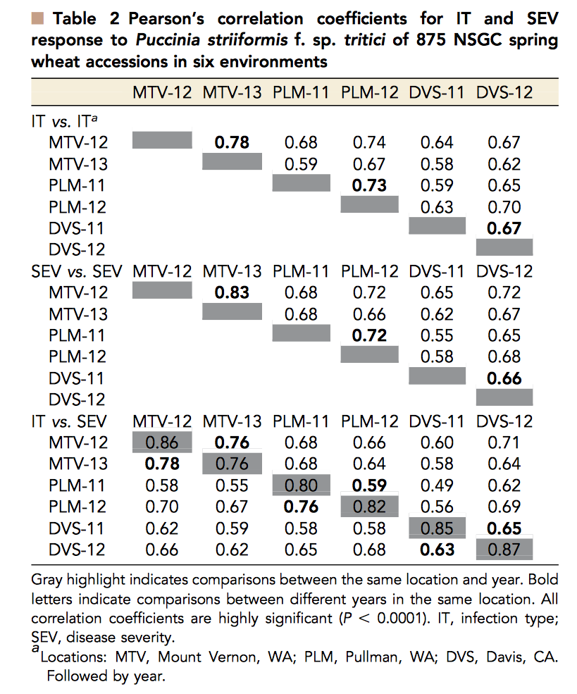
Response to PST in different environments
Notes:
To identify new sources of resistance to Pst that were effective in different environments of the western United States, we performed field evaluations in three locations with very different ecological con- ditions. Despite these differences, we observed high correlations among IT and SEV values obtained from the different environments

Slide 9
Identification of QTLs
73 regions showing marker-wise associations
7 significant QTLs
All samples from the 6 environments
35 regions showing marker-wise associations
3 new significant QTLs
Remove highly resistant infection types (0-3)
10 QTLs
5 also significant in seedlings
Notes:
Association analysis was performed separately for each of the six field environments to identify chromosome regions including Pst resistance genes effective against different combinations of Pst races. A total of 73 chromosome regions showed marker-wise significant associations with either IT or SEV in at least three environments (Table S4 and Figure S2). Among these QTL only seven were significant at the experiment-wise Bonferroni threshold of P , 0.10 and are described in Table 3.

Slide 10
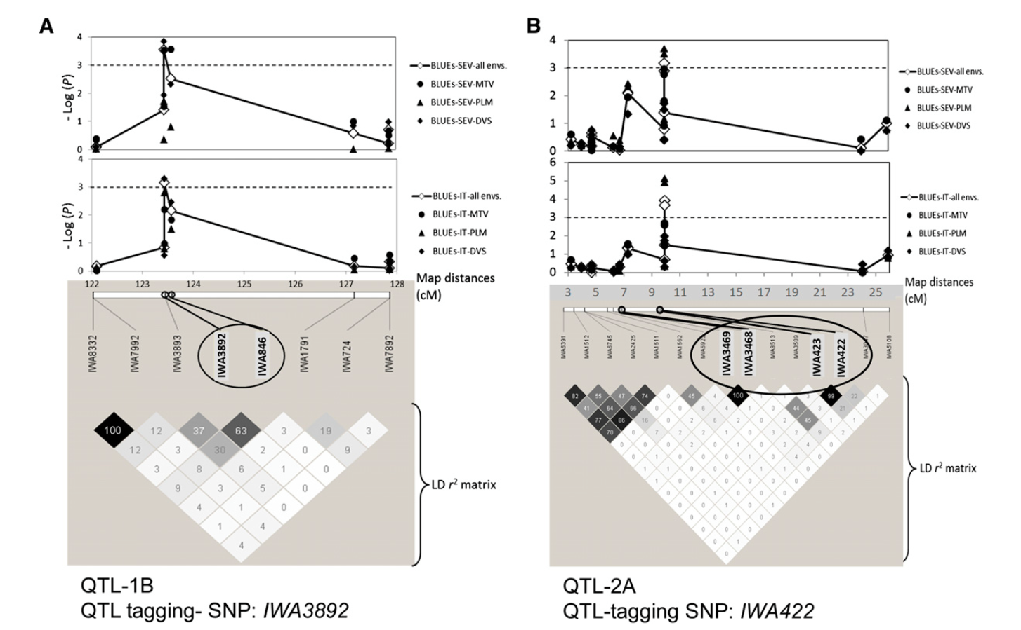
Identification of QTLs
Notes:
Association analysis was performed separately for each of the six field environments to identify chromosome regions including Pst resistance genes effective against different combinations of Pst races. A total of 73 chromosome regions showed marker-wise significant associations with either IT or SEV in at least three environments (Table S4 and Figure S2). Among these QTL only seven were significant at the experiment-wise Bonferroni threshold of P , 0.10 and are described in Table 3.

Slide 11
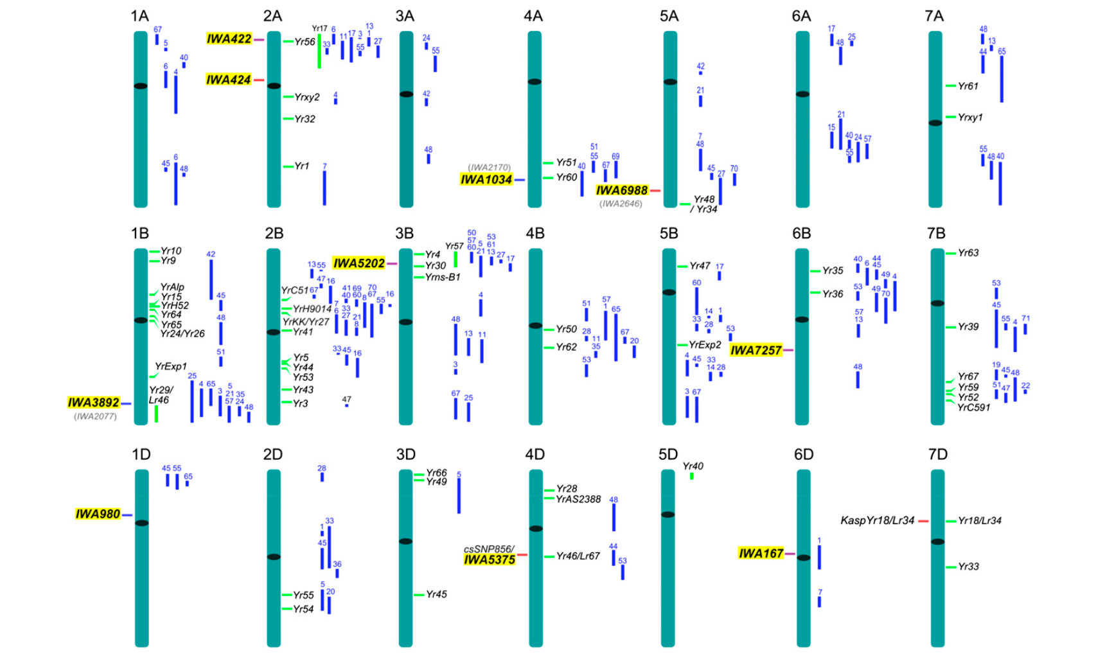
Known R genes (include NB-LRR) in Brachypodium and rice
No known Pst resistance genes
Mapped Pst resistance genes (<3 cM)
SNP marker associated with R gene
Notes:
Association analysis was performed separately for each of the six field environments to identify chromosome regions including Pst resistance genes effective against different combinations of Pst races. A total of 73 chromosome regions showed marker-wise significant associations with either IT or SEV in at least three environments (Table S4 and Figure S2). Among these QTL only seven were significant at the experiment-wise Bonferroni threshold of P , 0.10 and are described in Table 3.
To test whether additional partial resistance QTL were masked by the major resistance genes segregating in this panel, we performed a second set of GWAS in which 282 accessions with highly resistant infection types (ITs of 023) were not included in the analyses.
Among the 10 significant QTL reported in Table 3, IWA980, IWA424, and IWA7257 were mapped on chromosome regions where, to our knowledge, no Pst resistance genes or QTL were reported before. These results suggest that they are likely novel Pst resistance loci (Figure 6). IWA167, one of the most significant QTL detected in this study, was mapped within the flanking markers of a weak QTL from Cappelle Desprez (QYr.ufs-6D; Agenbag et al. 2012). However, the peak of QYr.ufs-6D was mapped on the long arm of chromosome 6D, whereas IWA167 is in the short arm. The different arm locations and the different strength of these two QTL suggest that they are likely the effect of different resistance genes (File S5). The IWA167 resis- tance allele was almost fixed in the subpopulation from South Asia (frequency = 0.95) and was found at very low frequency in some of the other subpopulations, suggesting that it might be a useful gene to diversify sources of resistance in wheat breeding programs outside South Asia.
QTL associated with IWA422, IWA5202, and IWA5375 were very close to previously mapped Pst resistance genes (, 3 cM) and likely represent alleles of these genes (File S5). The results from the last three significant loci (IWA3892, IWA1034, and IWA6988) are more difficult to interpret because each of them has a linked SNP marker that was also significantly associated (marker-wise) with Pst resistance in most of the locations tested in this study and will require additional allelism tests. In spite of these uncertainties, Figure 6 provides a good overview of the distribution of Pst resistance genes on the wheat chromosomes.
Since 2000, new aggressive strains of Pst were identified in three continents: North America, Australia, and Europe (Hovmoller et al. 2008). These races have increased aggressiveness and the ability to produce more spores at greater temperatures than before (Milus et al. 2009). These new races with broader spectra of virulences have gen- erated serious stripe rust epidemics in areas previously considered unsuitable for the disease, and have turned stripe rust into one of the most economically damaging wheat pathogens (Hodson 2011). Therefore, the identification of novel Pst resistance genes in this GWAS represents a valuable addition to the set of tools available to wheat breeding programs to fight this devastating pathogen.
This GWAS also provides a good overview of the distribution of resistance genes and the frequencies of the resistance alleles in different wheat subpopulations around the world. The frequency
information is particularly useful for wheat breeders interested in diversifying the sources of Pst resistance in their regional programs. In particular, wheat germplasm from the Himalayan and neighboring regions emerged from this study as a valuable source of resistance genes that are absent or present at low frequencies in other regions of the world.
elimina- tion of highly resistant accessions from a GWAS for disease resistance was a useful strategy to identify additional partial resistance genes. The incorporation and deployment of partial resistance genes is an impor- tant objective for wheat breeding programs because this type of re- sistance genes have historically provided more durable resistance than race specific resistance genes
The annotation of the proteins encoded by the Brachypodium and rice colinear genes was used to infer the putative function of the wheat genes from where the SNPs were derived. Among the wheat SNPs with a corresponding annotated rice or Brachypodium protein (Table S10), 12.7% were classified as R genes with two large groups in the confidence intervals for QTL IWA422 and IWA5202 (Table S10). Interestingly, the colinear regions for IWA422 (Brachypodium Chr. 5, 1.4324.20 Mb and rice Chr. 4, 0.0726.96 Mb) and for IWA5202 (Brachypodium Chr. 2, 0.7420.82 Mb and rice Chr. 4, 0.7220.92 Mb) include several NB-LRR and LRR- receptor-like kinases. These results suggest that this region may in- clude an ancestral R gene

Slide 12
Conclusions
GWAS provided a good overview of the distribution of resistance genes in different wheat subpopulations.
Wheat germplasm from the Himalayan and neighboring regions (4C) emerged as a source of resistance genes that are absent or present at low frequencies in other regions of the world.
Elimination of highly resistant accessions from a GWAS was a useful strategy to identify additional partial resistance genes.
Notes:
elimina- tion of highly resistant accessions from a GWAS for disease resistance was a useful strategy to identify additional partial resistance genes. The incorporation and deployment of partial resistance genes is an impor- tant objective for wheat breeding programs because this type of re- sistance genes have historically provided more durable resistance than race specific resistance genes
Pst resistance in the spring wheat core collection was governed by several resistance genes with relatively larger effects (Table 3) modulated by a larger number of genes with smaller effects (Table S4 and Table S5). This trait archi- tecture is different from the architecture found for resistance to downy mildew in a previous GWAS in Arabidopsis. The Arabidopsis study, which tested resistance at the seedling level using specific races and in controlled environmental facilities, detected few dominant resistance genes that were concentrated in only four genomic regions

Slide 13
Advantages of GWAS
Biological pathway of the trait does not have to be known
Potential to discover novel candidate genes not identified through other methodological approaches
Encourages the formation of collaborative consortia to recruit sufficient numbers of participants for analysis, which tend to continue their collaboration for subsequent analyses
Rules out specific genetic associations
Provides data on the ancestry of each subject, which assists in matching case subjects with control subjects
Provides data on two types of structural variants--sequence and copy-number variations-- which provides more robust data.
Limitations of GWAS
Results need replication in independent samples in different populations.
A large study population is required.
GWAS studies detect association not causation.
GWAS identifies a specific location, not complete genes. Many variants identified in GWAS are nowhere near a protein-coding gene, or are within genes that were not previously believed to associated with a trait or condition.
Detects only variants that are common (>5%) in a population
Typically, for any particular trait, the cumulative effects of multiple **SNPs only explains a small fraction of an individual's risk for the trait.

Slide 14
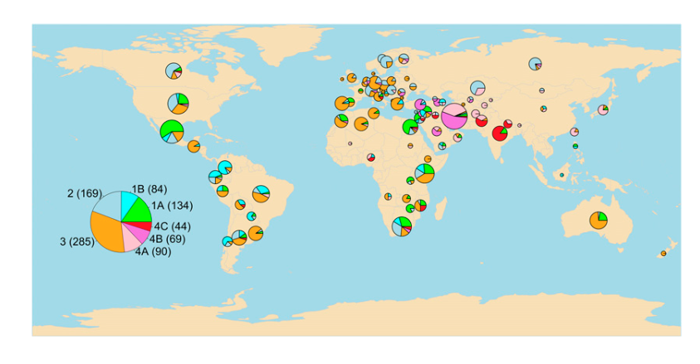

Slide 15
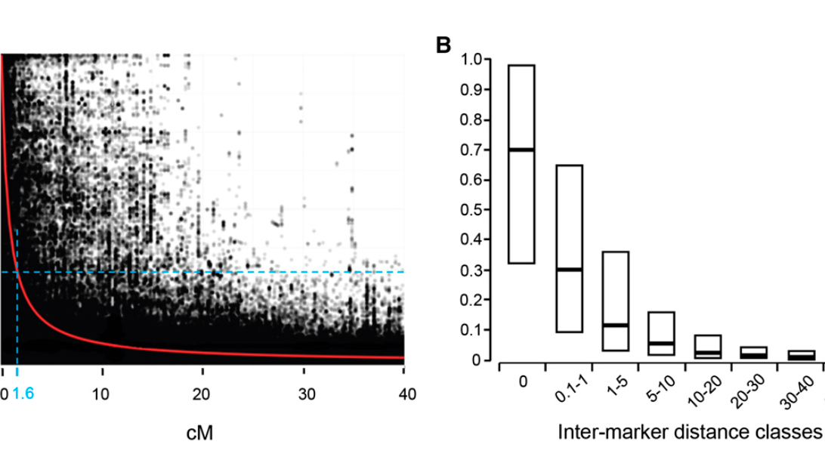
Notes:
the significance of the phenotype-SNP association (as –log P) is plotted along the consensus map (Cavanagh et al. 2013) and com- pared with local r2 LD patterns below. SNP-phenotype associations rapidly decayed within 1-2 cM, in accordance with the observed trend of LD decay rate estimated from SNP pairs

Slide 16
Notes:
To identify new sources of resistance to Pst that were effective in different environments of the western United States, we performed field evaluations in three locations with very different ecological con- ditions. Despite these differences, we observed high correlations among IT and SEV values obtained from the different environments

